Slide 1
Implementation of the EEE Extended Producer Responsibility (EPR) Program in the Nigerian EEE Sector
Presented by
@ the
EACO 5TH REGIONAL E-WASTE WORKSHOP ON SUSTAINABLE E-WASTE MANAGEMENT IN THE EAST AFRICAN REGION
March 21, 2023

Slide 2
Overview of Presentation
Evolution of the Nigerian EEE PRO
Governance Structure
Obligation of EPRON
Relationship with Government
Financing System
Integration of the Informal Sector

Slide 3
National Environmental (Electrical/electronic Sector) Regulations 2011
NESREA EPR Operational Guideline was developed 2014
LWG formed, sector EPR plan was developed and approved and a new definition of Producers evolved
EPRON was incorporated in 2018 and became operational in 2019

Slide 4
Government
(NESREA)
THE NIGERIAN EPR MODEL
Producers
(Manufacturers,
Importers,
Distributors,
Marketers, Retailers)
PRO
(EPRON)
Collectors
Recyclers
Informal Collectors
Consumers

Slide 5
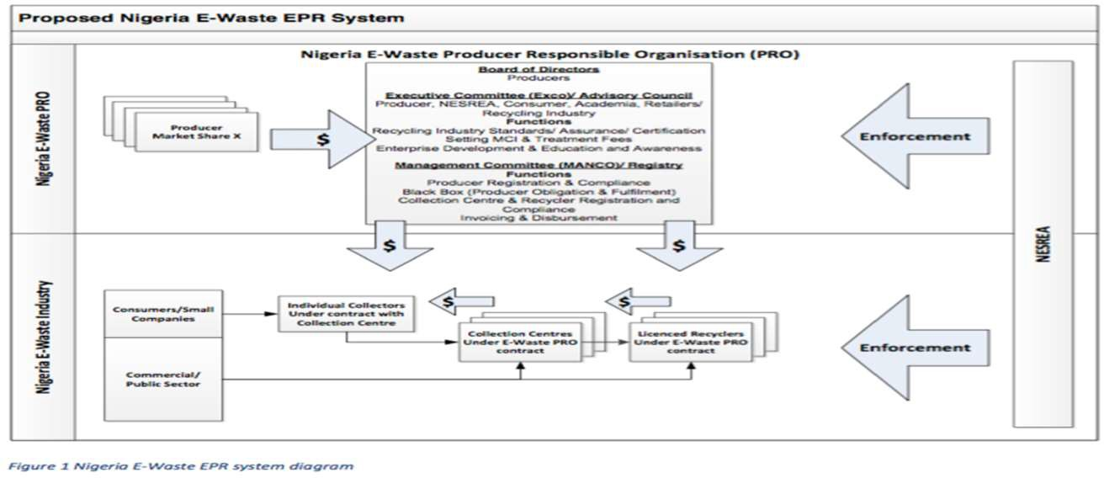
Notes:
Mandatory Approach Based on the National Environmental (Electrical/electronic Sector) Regulations 2022
Industry driven collective compliance system, not individual and not Government/tax driven
The PRO will not directly recycle but will work with registered recyclers and independent collectors
Currently relying on the best of two worlds principles of collecting and recycling to an extent and exporting hazardous fractions to more developed countries

Slide 6
Operational (May 2019)
Mission: To provide an industry led, regulatory compliant platform employing circular economy approaches for the environmentally sound management of e-waste in Nigeria
Vision: To be the benchmark for industry led Producer Obligation fulfilment for electrical and electronics equipment in Africa

Slide 7
EPRON’s Obligation
Register Producers and provide access for them to make their payments
Register Government Accredited Collectors that will meet EPRON Collection Criteria to serve as collection hubs and aggregate informal collectors into co-operatives
Register Recyclers who will collect e-waste from recyclers and manage in an environmentally sound manner
Enable Players to Domesticate Existing Standards
Raise Awareness
Data Management
Reporting to Government
Fund Management

Slide 8
Relationship with Government
Work with all the relevant Regulatory Orgs- FMEnv, State EPAs and Municipal Annual Fee to NESREA, Reporting
Revised Regulation, Guidance Document , Industry Standard

Slide 9
Financial Flows
Government
(NESREA)
Recyclers (recycle th valuable fractions & treats hazardous component)
Collectors (aggregate e-waste for recyclers)
Informal Collectors
System Flow
Accountability
Funding
Producers
Consumers (generate e-waste)
Material

Slide 10
Producers Funding
Administrative Fees
E-waste collection
Transportation
Recycling

Slide 11
Transitioning Informal Workers

Slide 12
Transitioning the Informal Sector
Registering them into Cooperatives
Assigning ID Card
Providing PPEs
Training
Incorporating them into formal collection arrangements

Slide 13
THANK YOU
Section subtitle here

